Slide 1

PUBG DATASET PREDICTION
Presented By :
Vineet Rathor

Slide 2
Content
About the Institute
Objective
Technology Used
Introduction to Machine Learning
Project

Slide 3
About the Institute
Foxmula is Online Learning Website owned by Inversion Consultancy Llp
Goal is to teach their students in a better way so that they don’t face difficulties. Their main characteristics are : Graduate Online, Problem Solving, Out of the box thinking, Collaborative viewpoints etc.
Website :- https://foxmula.com
Address :- Inversion Consultancy, RMZ Galleria, Ambedkar Colony, Yelahanka, Bengaluru, Karnataka 560064

Slide 4
Objective
PROBLEM STATEMENT: There are mainly two types of machine learning problems:-
Classification — the output variable takes class labels.
Regression — the output variable takes continuous values
Here, as the target variable (winPlacePerc) is a continuous variable, the problem comes under Regression problem.
PROJECT SUMMARY :The project titled ”PUBG Dataset Prediction” is use to predict the Win Place Percentage (final Placement) from the final in-game stats and initial player ratings of different players using Regression algorithms. First the machine is trained on the training dataset and then the algorithm is tested over the test dataset and the final output is in the form of new csv file which contains IDs with their predicted Final Placement percentage.
PURPOSE: The Purpose of making this project this project is to understand how different strategies can be used to win the game, and important reason is to understand which algorithm can perform better on a large dataset like this.

Slide 5
Technology Used
The following technologies are used:
Anaconda Software(Jupyter Notebook)
Coding in Python on Jupyter Notebook

Slide 6
What is Machine Learning?
Basic Definition: A computer program is said to learn from experience E with respect to some class of tasks T and performance measure P, if its performance at tasks in T, as measured by P, improves with experience E. [Mitchell]
Gives Computer the Capabilities to learn
Give power to Computer to predict something
Make Computer similar to humans
Training machine using good quality data
Scientific Study of algorithms

Slide 7
Basic Difference in ML and Traditional programming?
Traditional programming -> Feeding of data and program and then run it on machine gives the output
ML -> Feeding of data(Input and Output both) during training and then machine creates its own logic and predicts Output for new inputs

Slide 8
Basic four Types of Learning
Supervised Learning
Unsupervised Learning
Reinforcement Learning
Semi Supervised learning

Slide 9
Supervised Learning
Learning of algorithm using labelled data to predict output on new input
Data consists of numeric, string values such as classes
Similar to human learning
Learning of student under supervision of teacher using good example is same as supervised learning

Slide 10
Unsupervised learning
Learning of machine without guidance
No similarity b/w data
No labeling and unsorted data
Just as humans learn by figure out similarities between objects

Slide 11
Data sets
Testing Data
Validating data
The data set on which the testing of the algorithm is going to be done.
Once model is completely trained ,testing data set provide unbiased evaluation.
The data set which is used to do the frequent testing of model.
Fit on training data along with improving hyperparameters(initially set parameters before model begin learning)

Slide 12
Regression
Based on supervised learning
Relation between one variable with corresponding value of another variables
Models a target value based on independent variables
Output variable is real or continous value
Eg. Predicting house price based on locality,predicting stock price,predicting age of a person

Slide 13
Classification
Based on supervised learning
Classify the data in groups
Make group of similar type of data such as “disease” or “no disease”
One or more input and then predicting one or more output
Make conclusion on observed values
Eg. Predicting gender of a person based on handwriting,weather prediction

Slide 14
INTRODUCTION
TO
PUBG PROJECT

Slide 15

What is PUBG?
Online Multiplayer Battle Royale game
Max 100 players fight in either solo, duo or squads
However, there are events and custom games which allow team sizes more than 4.
The last person or the last team alive wins the match.
During the game, players search buildings, ghost towns to find weapons, vehicles, armor, and other equipment.

Slide 16
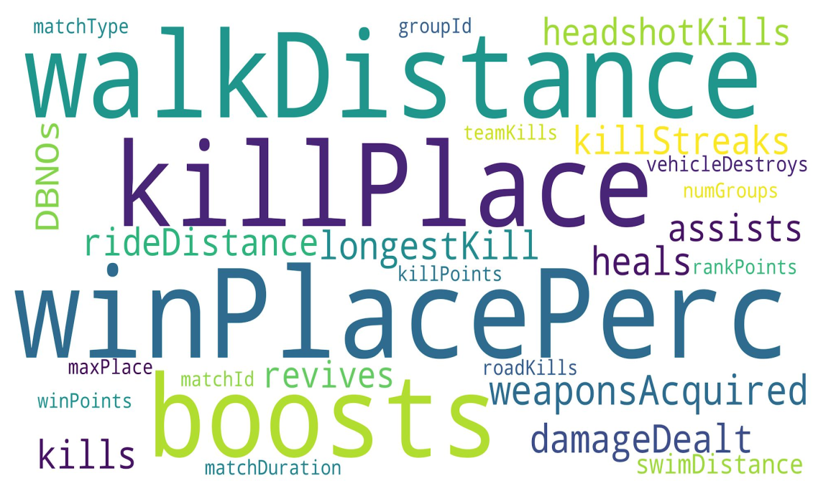
Dataset
Training Set: 4.45 million
Test Set: 1.93 million
Features: 28

Slide 17
PROCEDURE

Slide 18
Plotting different plots and gaining insights from the data
Removing NA and Infinity values, and handling categorical data
Fitting the test dataset on the best model and reporting Final MAE & R-squared
Exploratory Data Analysis
Feature Analysis
Pre
Processing
Model
Selection
Evaluation
Removing the Outliers in the data by using the Visualizations
Comparing different Regression models and calculating their MAE & R-squared

Slide 19
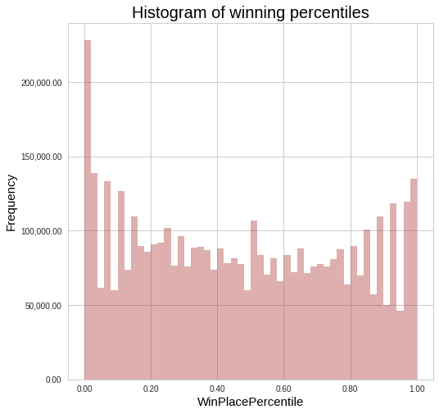
Distribution of Target Variable

Slide 20
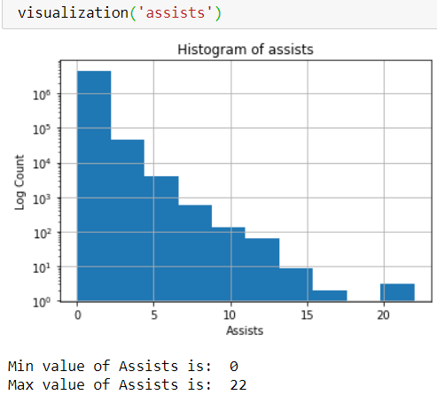
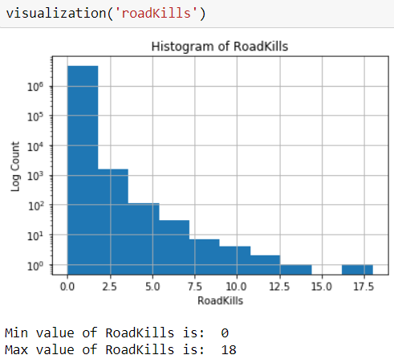
Visualizations
def visualization (col, num_bin=10):
title = col[0].upper() + col[1:]
f,axes=plt.subplots()
plt.xlabel(title)
plt.ylabel('Log Count')
axes.set_yscale('log')
df_train.hist(column=col,ax=axes,bins=num_bin)
plt.title('Histogram of ' + title)
plt.show()
tmp = df_train[col].value_counts().sort_values(ascending=False)
print('Min value of ' + title + ' is: ',min(tmp.index))
print('Max value of ' + title + ' is: ',max(tmp.index))

Slide 21
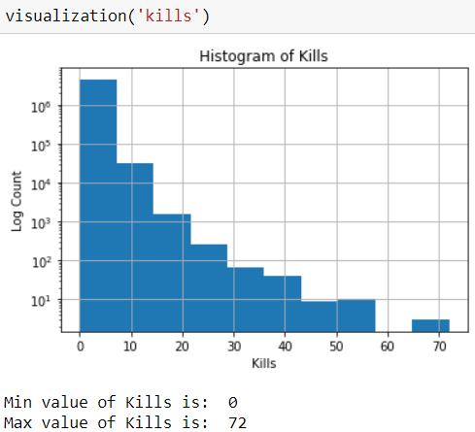
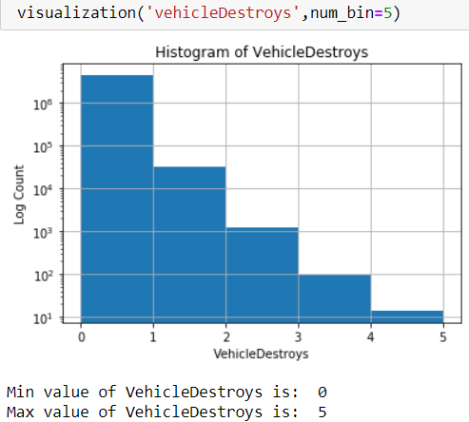
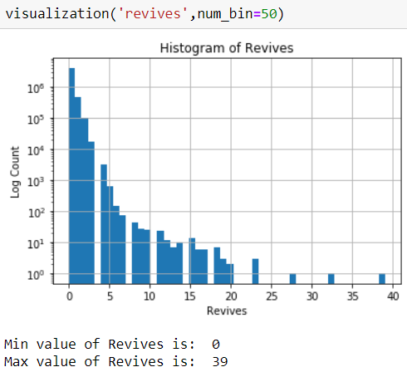
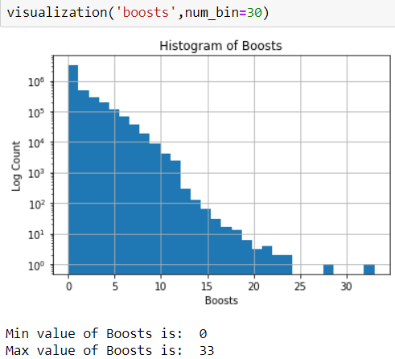

Slide 22
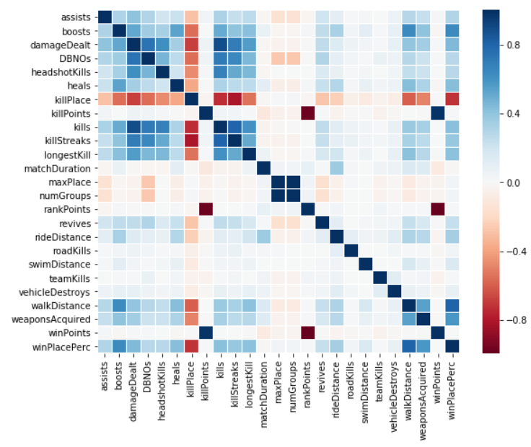
Correlation
cols_to_drop = ['Id','matchId','groupId','matchType']
cols_to_fit = [col for col in df_train.columns if col not in cols_to_drop]
corr = df_train[cols_to_fit].corr()
plt.figure(figsize=(9,7))
sns.heatmap(
corr,
xticklabels=corr.columns.
values,
yticklabels=corr.columns.values,
linecolor='white',
linewidths=0.1,
cmap='RdBu')
plt.show()

Slide 23
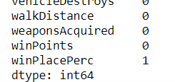

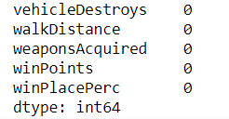
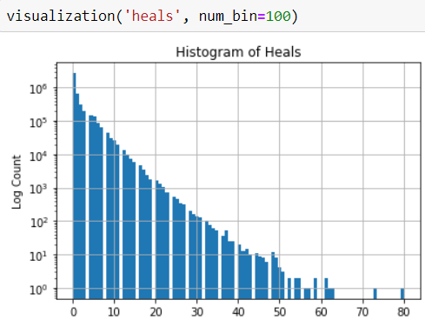
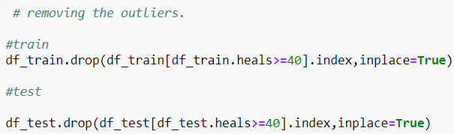
Preprocessing
Removing NAN Values :
Removing the Outliers :

Slide 24

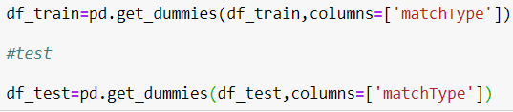
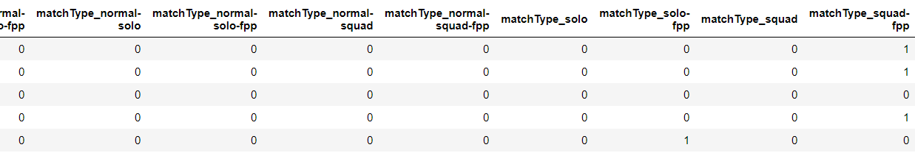
Converting categorical data to Numeric data :

Slide 25
Model Selection
Model Scores | Linear | Ridge | Lasso | Elastic Net | AdaBoost (lr=) | Gradient Boosting (lr=)
MAE | 0.08977 | 0.08977 | 0.12083 | 0.11297 | 0.09976 | 0.06176
R2 | 84.04% | 84.04% | 74.53% | 77.17% | 81.58% | 92.21%
Model Scores | Random Forest (n_est=) | Decision Tree | LGBM
MAE | 0.06063 | 0.08118 | 0.05455
R2 | 92.26% | 85.64% | 93.75%

Slide 26
Conclusion
Applied different algorithms on the dataset
LGBM gave the best results with MAE 0.05455
and R squared 93.75%
Future Scope:
For future work, we will train the AI to play PUBG and win. With the results we have arrived at, we will train the bots to maximize the exponentially decayed sum of future rewards with data produced entirely from self-play, that is, the bots are playing against themselves to learn to play by the strategies that maximize their chances of winning. By building AIs that succeed in complex and dynamic games like PUBG, We could use them in the army to fight against our enemies and help to protect our soldiers’ lives.

Slide 27
Thank You

